Slide 1

AI Testing Quality Evaluation
- Prepared by Jerry Gao

Slide 2










Quality Parameters for AI Function and System
System Reliability
Function/System Accuracy
Function/System Correctness
System Performance
Function/System Consistency
AI Software
System Robustness
Function/System Relevancy
System Scalability

Slide 3


Quality Criteria Level | Description | Consistency | Accuracy | Correctness | Description Relevance
Level #0 | No direct solution response
 | Don’t know the answer (or no answer)
 | Understanding and display the given question
Level #1 | Display direct solution Or Display a solution without a detailed procedure
 | No related information is displayed
Level #2 | Display direct solution Or Display a solution a with procedure
 | Related information is provided
Level #3 | Provide more than solution procedure details
 | Related information is provided
Level #4 | Support more than questions and answers
 | Related information is provided
Linear algebra question
& answer
- Image-Based AI Function
Quality Assessment Criteria

Slide 4

Quality Criteria Level | Description | Consistency | Accuracy | Correctness | Description Relevance
Level #1 | Object detection
 | Object recognition
 | Object counting
Level #2 | Object classification
 | Object sub-classification
Level #3 | Object property detection And illustration
 | Object attributes detection and illustration
 | Object position/orientation detection and illustration
Level #4 | Object behavior detection
 | Object behavior classification
 | Object behavior illustration
Level #5 | Context and background identification
 | Context and background classification
Image/Computer Vision
-Based AI Function
Quality Assessment Criteria

Slide 5


Quality Criteria Level | Input Type | Description | Consistency | Accuracy | Correctness | Description Relevance
Level #1 | Text | Word translation from Language A to Language B (word coverage)
 |  | Idiom translation from Language A to Language B (idiom coverage)
Level #2 | Text | Sentence translation from Language A to Language B
 |  | Different types of sentences (types and structure coverage)
Level #3 | Text | Text paragraph translation from Language A to Language B (syntaxes and semantics coverage)
Level #4 | Text | Text paragraph translation from Language A to Language B
 |  | More than one translation versions
Language/Context Translation
Function (google translate)
- Quality Assessment Criteria
Different text contexts:
Manual
MOU
Contract
Letter
Instruction
Book, …

Slide 6
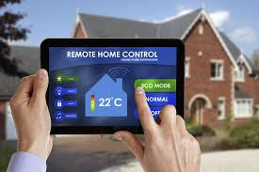
Quality Criteria Level | Input Type | Description | Consistency | Accuracy | Correctness | Description Relevance
Level #0 | Voice | Understand the given voice commend and display it
 |  | Don’t understand the given voice commend and display “don’t know” or “wrong commend”
Level #1 | Voice | Understand a given voice commend and perform the corresponding action
Level #2 | Voice | Understand multiple voice commands in a sequence in the same voice sample and perform them in a expected sequence
Level #3 | Voice | Understand a voice command in different contexts, and perform the expected action
Level #4 | Voice | Understand a voice command in different noise contexts with no, and perform the expected action
Voice Recognition Based Smart
Home Control System
- Quality Assessment Criteria

Slide 7





AI Testing Quality Assessment Services
AI Test
Model
Quality
Evaluation
AI Test Data
Quality Evaluation
AI Test
Quality Service
AI Test
Model
Coverage
Analysis
AI Test Quality
Evaluation

Slide 8
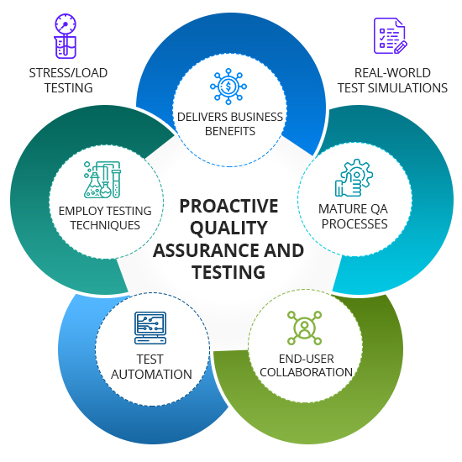








AI Testing Quality Evaluation
AI REQ Testing
AI Model Testing
AI Function
Classification
Testing
AI System
Testing and
Quality Assurance
White-Box
Black-Box
AI Test Automation
Learning-Based Testing

Slide 9

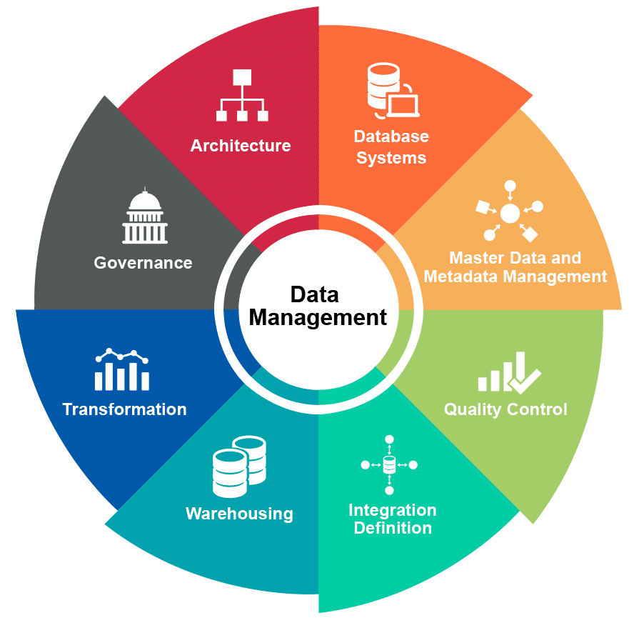









AI Testing Quality Evaluation
Rq
?
M
AI Requirements
Test Coverage
Ad-Hoc
Test Coverage
S
AI Model-Based
Test Coverage
Data Sample Based
Test Coverage
D
C
Data Model
Test Coverage
Classification
Test Coverage
Metamorphic Test Coverage
Rule-Based
Test Coverage
M
R

